Slide 1

The Third Space
Web based platform to promote arts & crafts and DIY projects from Pakistan, earn money through purchases and facilitate the marginalized communities

Slide 2
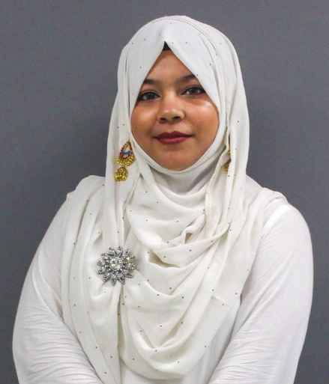
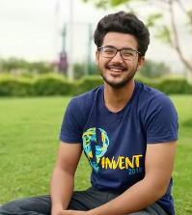

Team Members
We are a diverse team of individuals eager to impact the society for the greater cause.
Aiman Ahmed Moin
CS 2020
Server side development of website
Training and implementing AI model
UI design & illustration
Ubaid Ali Faruqi
CS 2020
UI design
Scrum master
Client-side development
Ahsan Qadeer
CS 2020
Full stack developer
Quality assurance
Databases, datasets and UI design

Slide 3
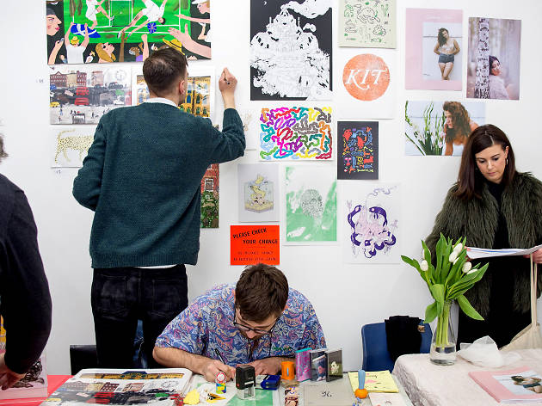


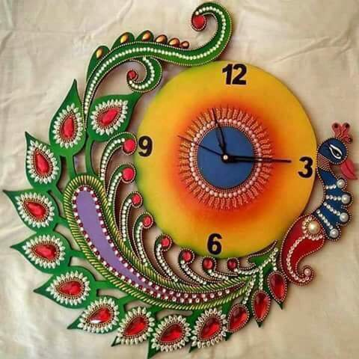
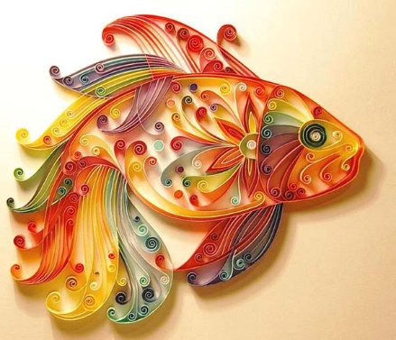
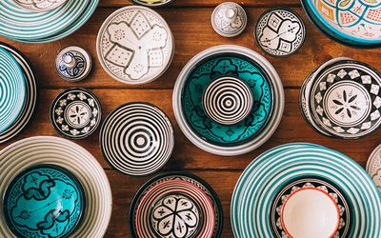
Neglected Issues in Our Society
Rights and Employment of Transgender.
Job Opportunities.
Web based platform to facilitate artists and skilled workers
94.2% unemployment rate

Slide 4

Our Mission (Deliverables)
To deliver an intelligent E-Commerce site with a running AI system to recognize the image object and categorize them accordingly. This Web Application will support artists and artisans to promote their work & skills and earn a respectable living, regardless of any biases.

Slide 5









Similar ideas around the world

Slide 6
Why Do We Care?
Pakistan, in general, has immense amount of talent with reference to art and culture.
Art promotion in Pakistan is not given significant importance with respect to sales and purchase.
An online platform is the cheapest and easiest way to reach maximum global market.
As a bearer of Yohsin philosophy, we aim to cultivate the talent from neglected classes and communities (precisely the transgender community) and help them earn a respectable living.

Slide 7
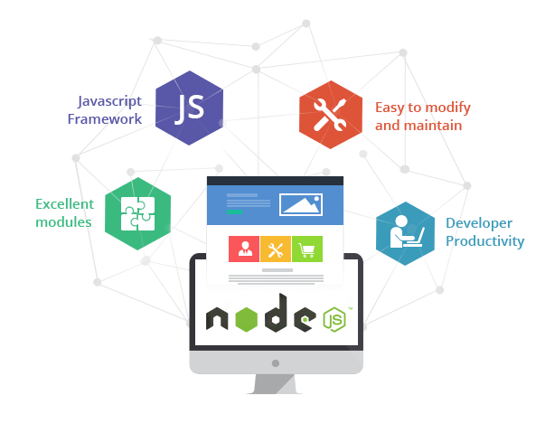



Major Components of our Project
Database Systems
Artificial Intelligence
Deep Learning
Data science
Machine Learning
Digital Image Processing
Web and App Development
Web and App Development
Intro To Illustration
Design Thinking
Entrepreneurship and Management

Slide 8







Tools and Technologies
We will be using technologies to train our model, build our website, maintain our repository and design our user interface.

Slide 9


Slide 10
Feedback given and questions raised

Slide 11
Revised Solution

Slide 12
What are we doing now

Slide 13
Title and Content Layout with Chart

Slide 14
Two Content Layout with Table
First bullet point here
Second bullet point here
Third bullet point here
Class | Group A | Group B
Class 1 | 82 | 95
Class 2 | 76 | 88
Class 3 | 84 | 90

Slide 15
Two Content Layout with SmartArt
Group A
Task 1
Task 2
Group B
Task 1
Task 2
Group C
Task 1
First bullet point here
Second bullet point here
Third bullet point here

Slide 16
Add a Slide Title - 1

Slide 17
Add a Slide Title - 2

Slide 18
Add a Slide Title - 3

Slide 20
Add a Slide Title - 5

